Slide 1
Overview of tonight’s class
Quiz
Homework 3
MVC
UML Realization/Generalization/Specialization
Midterm Information
SOLID Principles: Dependency Inversion Principle and Dependency Injection
Homework 4

Slide 2
Quiz

Slide 3
Homework 3
TextUI
PopupUI
Control
CmdOut
CmdIn
CommandHistoryObj

Slide 4
MVC
Stands for Model, View, and Controller
Model: Data model (DTOs and related classes)
View: The UI
Controller: Communicates between the data model and the UI.

Slide 5
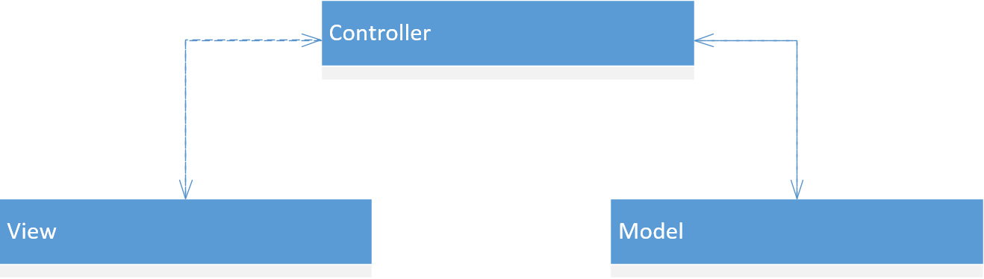
MVC
What do you notice about this diagram?

Slide 6
MVC
Notice that View and Model modules never talk directly to each other

Slide 7
MVC – why is it a good thing?
Think about Homework 3 and the Control class. This is the “controller” in our program. How many UIs did the program support? What changes to the Control class and the Data package (the Controller and Model modules) do we need to make to support more UIs?

Slide 8
MVC – Why it works
Because the “controller” logic is in this one class and this class depends on abstractions, we can add any number of UIs, as long as they implement those abstractions.

Slide 9
UML class diagrams: Specialization/Generalization
Specialization is when you have some base class and you create subclasses that inherit from that base class
Generalization is when you have a few classes and decide to create one base class for those classes to inherit from

Slide 10
Specialization/Realization
Which SOLID principle do you need to be cognizant of when deciding to Generalize? Why?

Slide 11
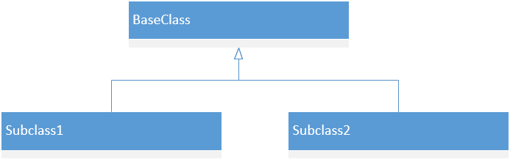
Specialization/Generalization class diagram
Depending on what class(es) came first, this diagram shows specialization/generalization. When you see a diagram like this, you can just say it shows “inheritance”

Slide 12
UML class diagrams: Realization
Realization is the implementation or derivation of an Interface or Abstract class. A Subtype realizes the Interface/Abstract class
Command and Strategy patterns are examples of realization

Slide 13
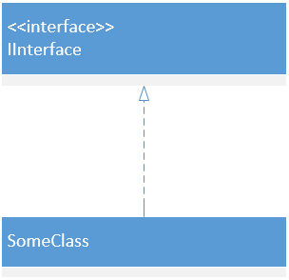
Realization UML diagram
SomeClass realizes IInterface

Slide 14
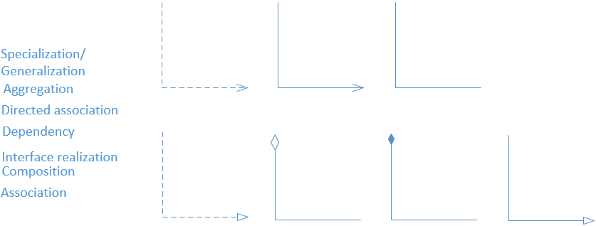
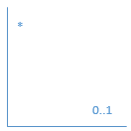
Uml arrows quiz

Slide 15
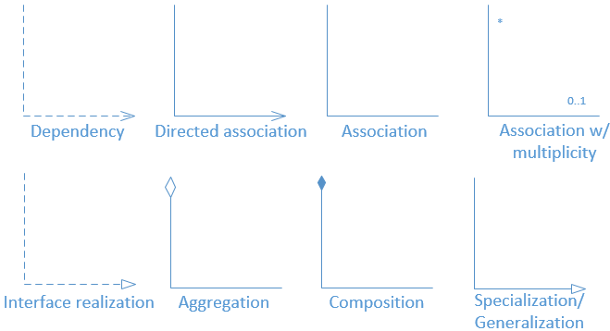
Uml arrows quiz

Slide 16
Class diagram quiz
Create a class diagram of the following (assume public visibility unless specified):
Person class
Private String SSN field
Public String name field
Public IPet pet field
Constructor accepts IPet pet
Protected Boolean hasPet() method
Package private IPet getPet() method
Static String getType() method
IPet interface
- Void speak() method
Dog class
Implements IPet
Static factory class PetFactory
- public IPet createPet(String petType) method

Slide 17
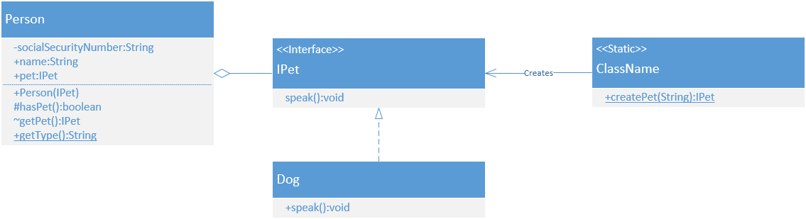
Class diagram quiz

Slide 18
Midterm information
http://fpl.cs.depaul.edu/jriely/450/lectures/class-04-001.html

Slide 19
Midterm: quick guide
Interface
Type of an object. Defines behaviors the object implements
Class
Definition of an object, including behaviors and state (fields)
Constructor
Code that runs when an object is initialized to setup the object’s initial state
Delegation
Allowing some other object to provide the behavior (e.g. lambdas)
Subclassing
Allowing some other class to provide behavior (e.g. abstract classes, interface implementations)

Slide 20
Midterm: quick guide
Immutable Data Class
Object whose state does not change (e.g. String)
Mutable Data Class
Object whose state can change
Collection Class
Encapsulates a collection of objects. Can be either immutable or mutable

Slide 21
Midterm: quick guide
MVC
IO logic (View) is separate from business logic (Model).

Slide 22
Midterm: quick guide
Static Class
Class that does not have an instantiable state, defines only global fields and methods

Slide 23
Midterm: quick guide
Static Factory
Static class whose purpose is to generate instances of some concrete interface implementations. The interface and factory are public, but the interface implementations are not
Builder
A mutable object used to build an immutable object. Add pieces to the builder bit by bit, then convert into an immutable object

Slide 24
Midterm: quick guide
Command
Encapsulate a message in an object.
Strategy
Encapsulate behavior into it’s own object. Receiving objects delegate behavior to a method parameter or field

Slide 25
DIP Definitions
Abstractions: abstract classes, interfaces
Low level module: does more of the nitty-gritty; the details of the implementation
High level module: more abstract module made up of lower-level modules
Notes:
Dependency Inversion Principals

Slide 26
SOLID: Dependency inversion principle
States:
High-level modules should not depend on low-level modules. Both should depend on abstractions
Abstractions should not depend on details. Details should depend on abstractions

Slide 27
Dependency inversion principle
Called Dependency Inversion because we are inverting the structure of the application so dependent modules are no longer dependencies – they are controlled by higher-level modules (but as abstract classes)
Tenet 2: Black box: implementation is up to the Interface/whatever is passed in. Separation of concerns

Slide 28
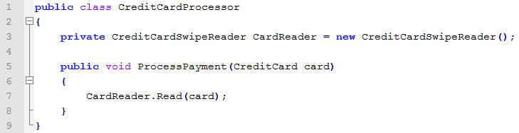
DIP – Example
Example: CreditCardProcessor and SwipeCardReader. Processor processes payments, and the card reader reads the credit card that’s passed in.
We now need to add functionality for a CreditCardChipReader. What is the best way to modify this class to support CreditCardChipReader?

Slide 29
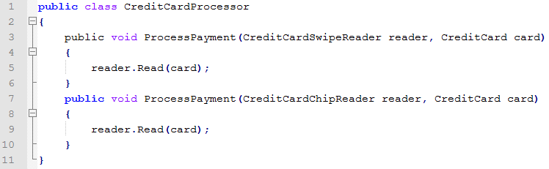
DIP – Example
Don’t pass in the two CardReaders as an argument to different functions. This leads to code bloat and the CreditCardProcessor will need to be updated anytime there is a new Reader implemented (such as TapCardReader.

Slide 30
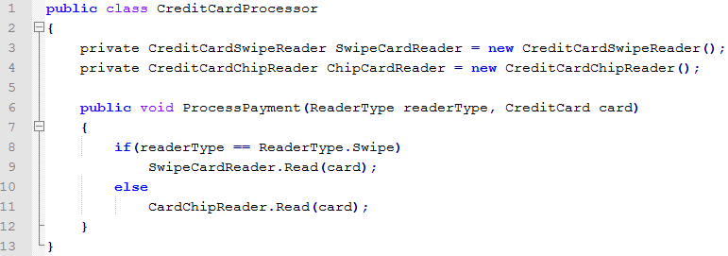
DIP – Example
Don’t pass in an enum to determine which type of Reader to call. This leads to long if/else blocks.
(code bloat).

Slide 31
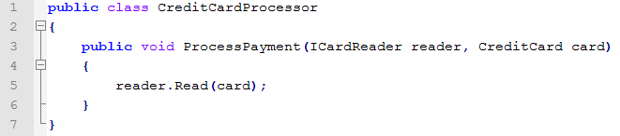
DIP - Example
Do:
Update dependencies so they implement an interface or abstract class
Pass in an interface or abstract class as a parameter to the method

Slide 32
DIP - Example
Following DIP requires little extra work:
Create an interface
Update both readers to implement that interface
Both readers already have the Read method implemented

Slide 33
DIP - Example
High-level modules should not depend on low-level modules. Both should depend on abstractions
Abstractions should not depend on details. Details should depend on abstractions

Slide 34
DIP - Example
Tenet 1: Processor (high-level) depends on interface; CardReader (low-level) depends on same interface
Tenet 2: Reader implementation details left up to the specific implementation of ICardReader. Processor doesn’t care what the implementation is, or which type it is. It only cares that it can read the card.

Slide 35
DIP – Finding the Abstraction Example
Example: Credit Card Processor – Is this fully following the DIP?

Slide 36
DIP – Finding the Abstraction Example
There is still a dependency on CreditCard, but does it need to be abstracted, or will that cause unnecessary complexity?

Slide 37
DIP – Finding the Abstraction Example
Need to think about whether an ICardReader needs to receive a CreditCard
What if you want to implement Apply Pay or Google Wallet?

Slide 38
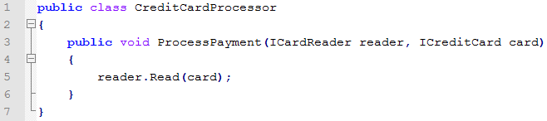
DIP – Finding the Abstraction Example
Inverting the CreditCard dependency allows us to be able to accept anything that implements the ICreditCard interface, such as CreditCard Information from a mobile device.

Slide 39
DIP – Finding the Abstraction Example
In addition, this change removes a second dependency. Do you see it?
Notes:
Removes the dependency on CreditCard in ICardReader’s Read method.

Slide 40
DIP – What does it solve?
Enables ability to reuse high-level modules for different purposes
We can now reuse the ProcessPayment logic with all sorts of CardReaders and CreditCards
This logic is simple, but imagine if was more complex.

Slide 41
DIP – What does it solve?
Reduces/Removes Transitive Dependencies (improves use of Layers)
Transitive dependency would be if Class A depends on Class B, and Class B depends on Class C, then Class A depends on Class C.
Changes to Class C would affect Class A.

Slide 42
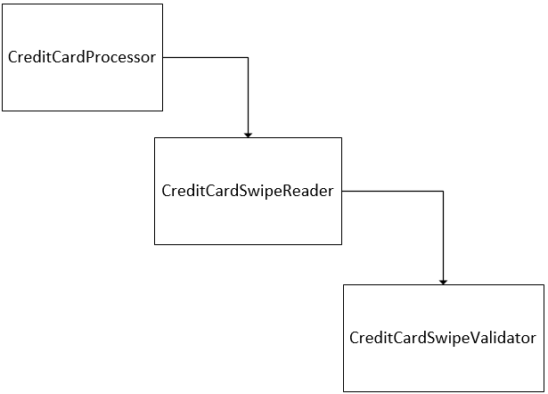
DIP – transitive dependencies
CreditCardSwipeReader has a dependency on CreditCardSwipeValidator
Transitively, CreditCardProcessor has dependency on CreditCardSwipeValidator.

Slide 43
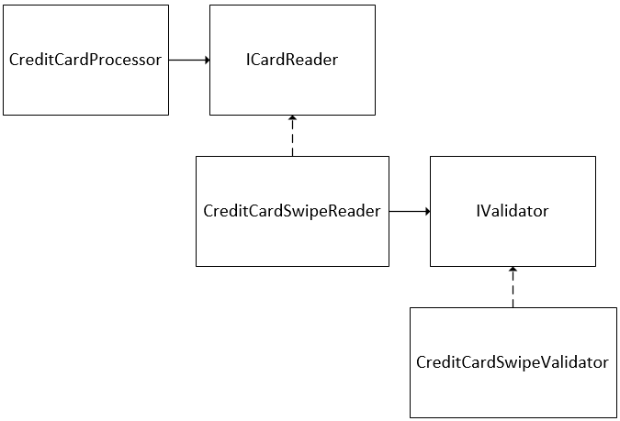
DIP – transitive dependencies
After refactoring for DIP, CreditCardProcessor only has dependency on ICardReader, changes to CreditCardSwipeReader and CreditCardSwipeValidator no longer affect CreditCardProcessor.

Slide 44
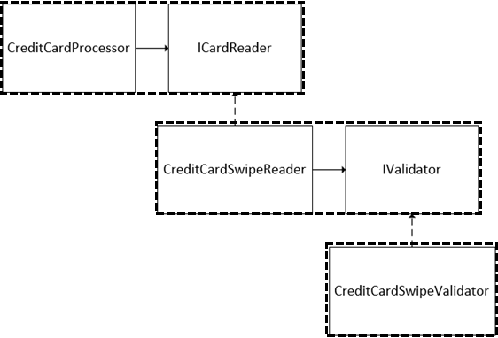
DIP - Name

Slide 45
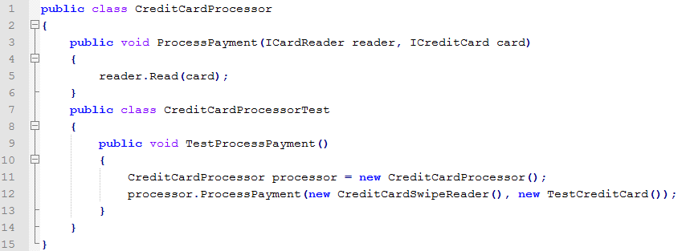
DIP – what does it solve?
Improves testability

Slide 46
DIP - Testing
You can use a TestCreditCard which implements ICreditCard, so when the card needs to be read, rather than needing to swipe it, the TestCreditCard can just say it’s been read and return data.

Slide 47
DIP - Testing
The benefit of using the testCreditCard is you can isolate testing on just the Reader classes. You can use a TestCardReader when you want to test the different types of CreditCard.

Slide 48
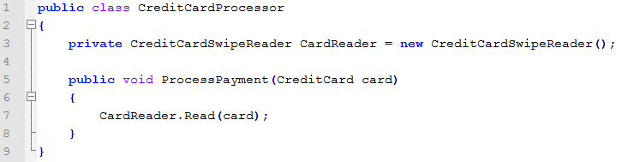
DIP – What issues does it solve?
Tight Coupling
Modules are heavily dependent on other modules making it difficult to reuse or make modifications to without affecting others

Slide 49
DIP – What issues does it solve?
Rigidity
Changing code in one place leads to many parts of the application needing to be changed
With the old code, we couldn’t just add a CreditCardChipReader, even though their functionality was very similar. Without using the DIP, we would need to make a lot of changes to the code base just to support it.

Slide 50
DIP – What issues does it solve?
Fragility
Changing code in one place breaks many different places

Slide 51
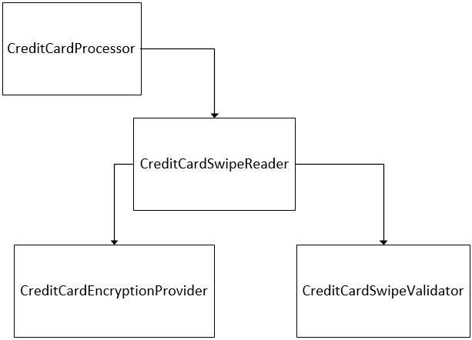
DIP – What issues does it solve?
CreditCardSwipeReader has a dependency on CreditCardSwipeValidator. Let’s say you want to add a dependency to CreditCardEncryptionProvider. The CreditCardProcessor is now more fragile because there is an increased potential for breaking, since now changes to the EncryptionProvider affect CreditCardProcessor (via transitive dependency).

Slide 52
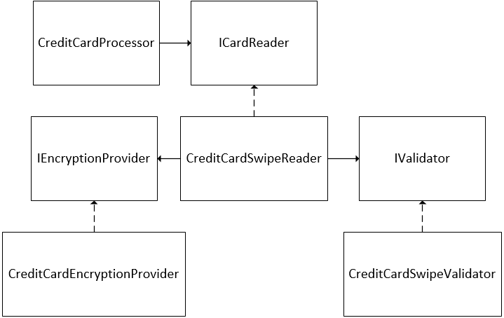
DIP – What issues does it solve?
If you change it to use DI, CreditCardProcessor no longer has that second transitive dependency and it’s much less fragile.

Slide 53
DIP – What issues does it solve?
Immobility
Difficult to reuse code in another application

Slide 54
DIP – What issues does it solve?
Let’s say you want to reuse this code in another application that has its own CreditCard and CreditCardSwipeReader implementation. Because this code is so dependent on this implementation of CardReader and CreditCard, CreditCardProcessor can’t be easily reused.

Slide 55
DIP – What issues does it solve?
Using DIP:
New classes can implement the ICardReader and ICreditCard interfaces and this module can be reused without needing any changes
If the new CardReader and CreditCard implementation are in an external library, you can easily create Proxy classes that implement the interfaces.

Slide 56
Dependency Injection
Method(s) for adhering to the DIP
Three types:
Constructor Injection
Method Injection
Field (Property) Injection

Slide 57
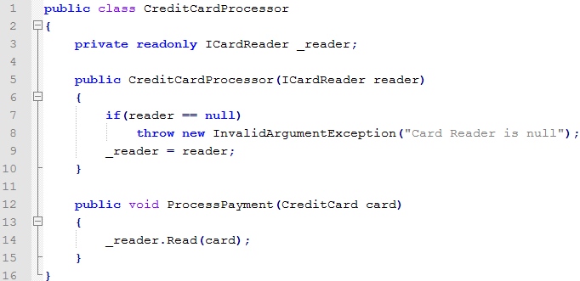
Constructor Injection
Pass dependencies to an object via the Constructor (notice the guard clause to ensure the dependency is fulfilled):

Slide 58
Constructor Injection
Use Constructor Injection if you want to allow the creator in the higher-level module to specify which type to use to fulfill the dependency and to force the lower level class to only use the one object. Make sure the dependency field is private and readonly.

Slide 59
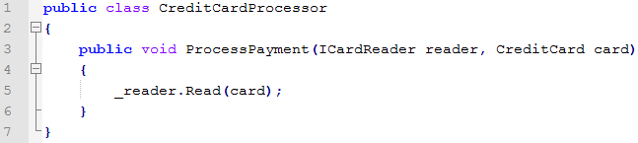
Method Injection
Pass dependencies to a method via a parameter:

Slide 60
Method Injection
Use Method Injection to allow the caller to specify which type to use to satisfy the dependency. This also allows the object that accepts the dependency some flexibility during its lifespan.

Slide 61
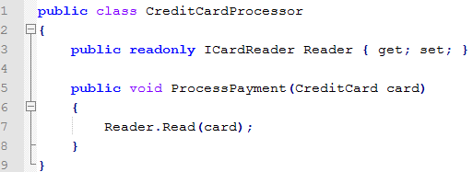
Property (field) Injection
Property injection is when the dependency is inserted into a property (or field in Java)

Slide 62
Property Injection
Useful for cross-cutting concerns (e.g. Settings, inputs/outputs).
Allows any object anywhere to specify an object to satisfy the dependency. Can set a default value in the constructor (optional).

Slide 63
Composition root
Place in code where all the objects are created. This is likely the Main method. It’s probably best to use a factory to create everything.

Slide 64
DI containers
Using DI is a bit of a pain, unless you use a DI container (alternatively called IoC Container).
(IoC stands for Inversion of Control, which is another way of saying Dependency Injection)
Containers use configuration to automatically set up objects with their dependencies (constructor injection or property/field injection) when the code needs them. Easiest to think of it like a factory.

Slide 65
Visio demo

Slide 66
Homework 4
http://fpl.cs.depaul.edu/jriely/450/lectures/hw-04-001.html

